Slide 1
DEMO BLAZE
IT IS A demo WEB BASED SHOPPING WEBSITE FOR E-COMMERCE DOMAIN.

Slide 2
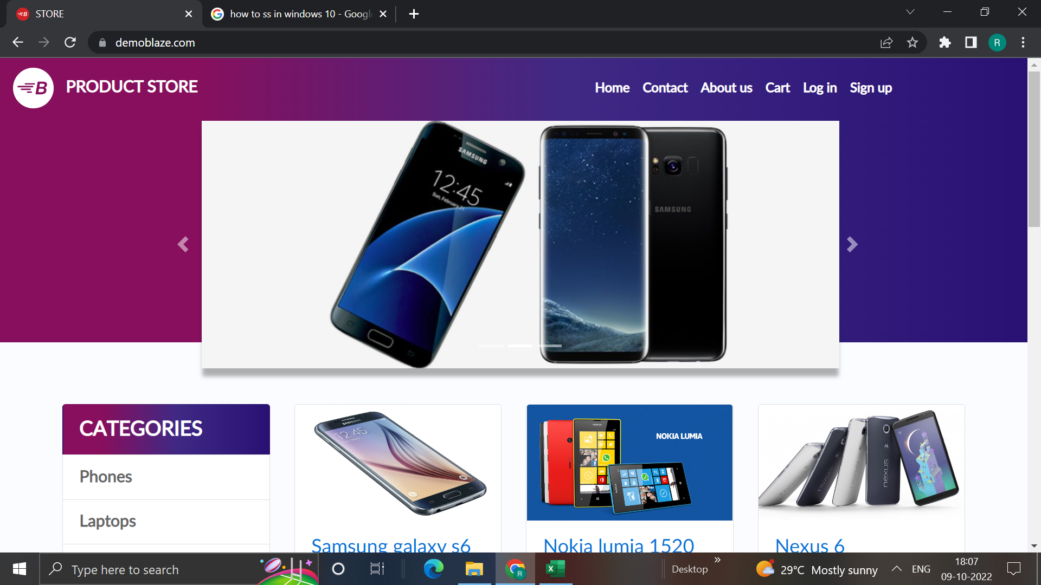
INTRODUCTION :-
Blaze is a Web-Based Shopping Website of E-Commerce Domain.
It is developed in PHP using MySQL database management system.
The free online shopping websites is very easy as you get to shop from the comfort of your home and get products delivered at your doorstep.

Slide 3
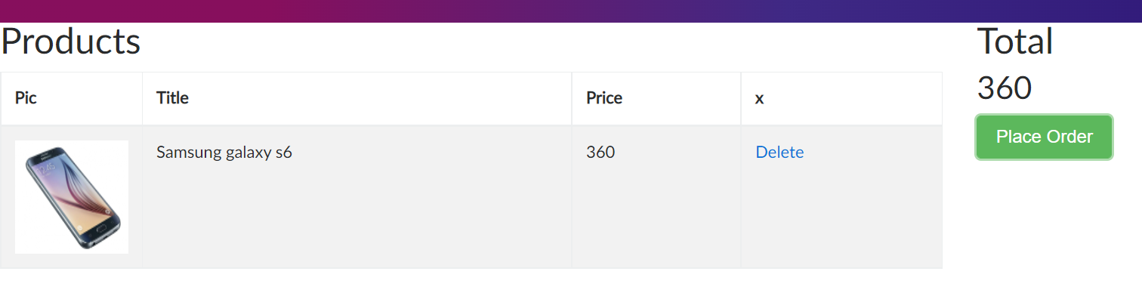
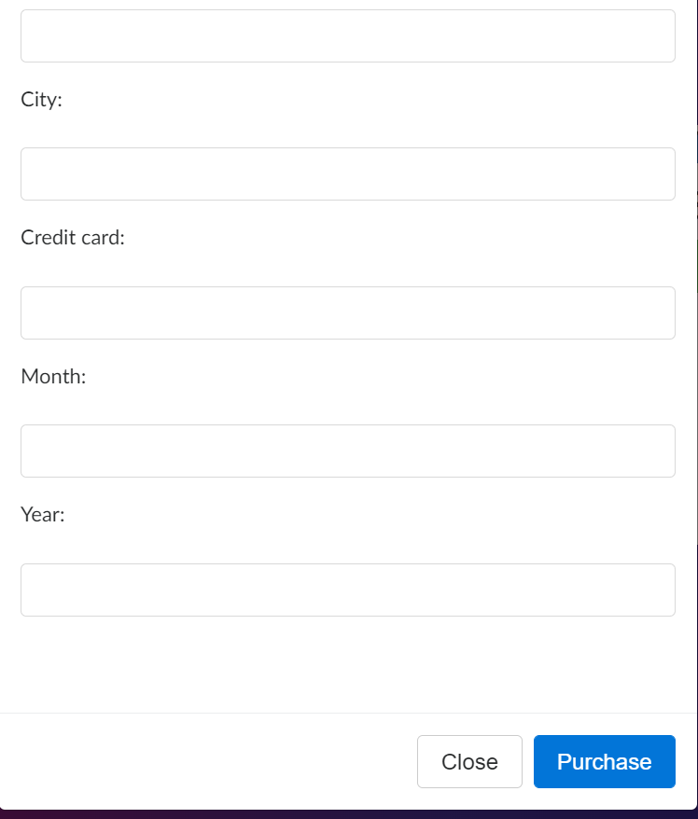
FEATURE NOT TO BE TESTED :-
PURCHASE ORDER
ABOUT US

Slide 4

FEATURE TO BE TESTED :-
LOG IN
SIGN UP
ADD TO CART
CONTACT US

Slide 5
TEST APPROACH :-
Method of Testing :-
Black Box Method
Levels of Testing :-
System Testing
Types of Testing :-
Functional Testing
GUI Testing
Usability Testing

Slide 6
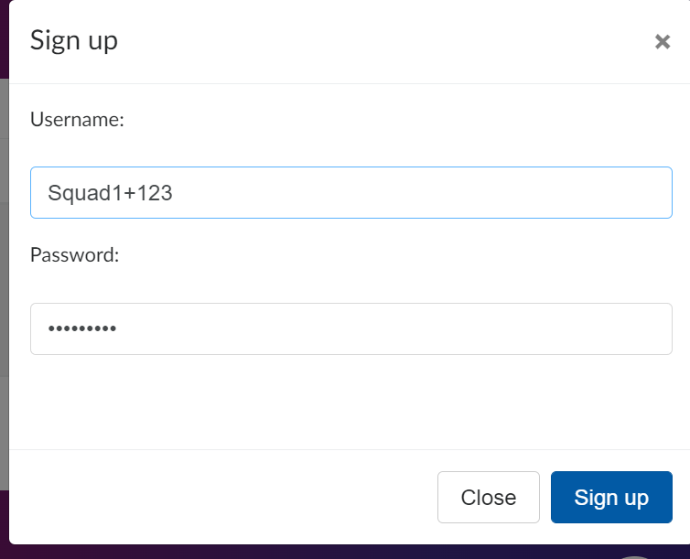
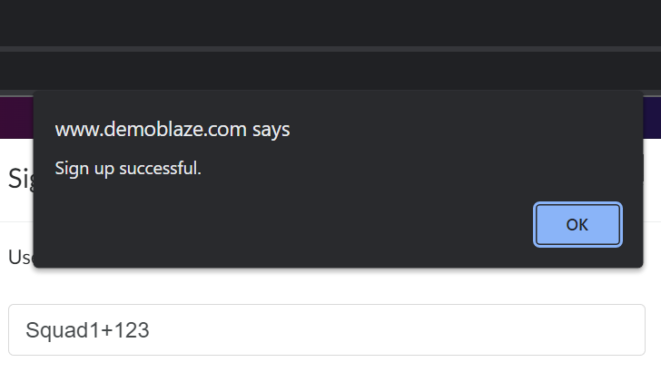
Sign Up
.

Slide 7

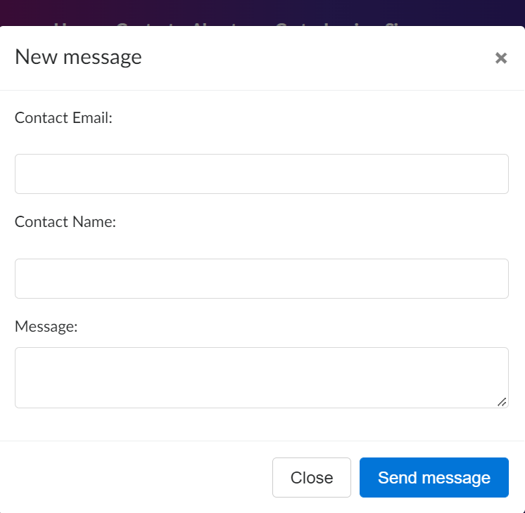
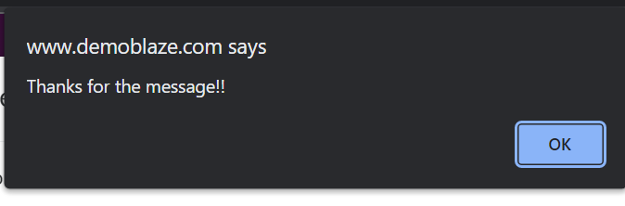
Contact Us :-

Slide 8
THANK YOU…!

